Slide 1


Group 6
Committee:
Dr. Mustafa ‘Mert’ Bayer
Dr. John Aedo Professor Mark Maddox
Notes:
Mario

Slide 2
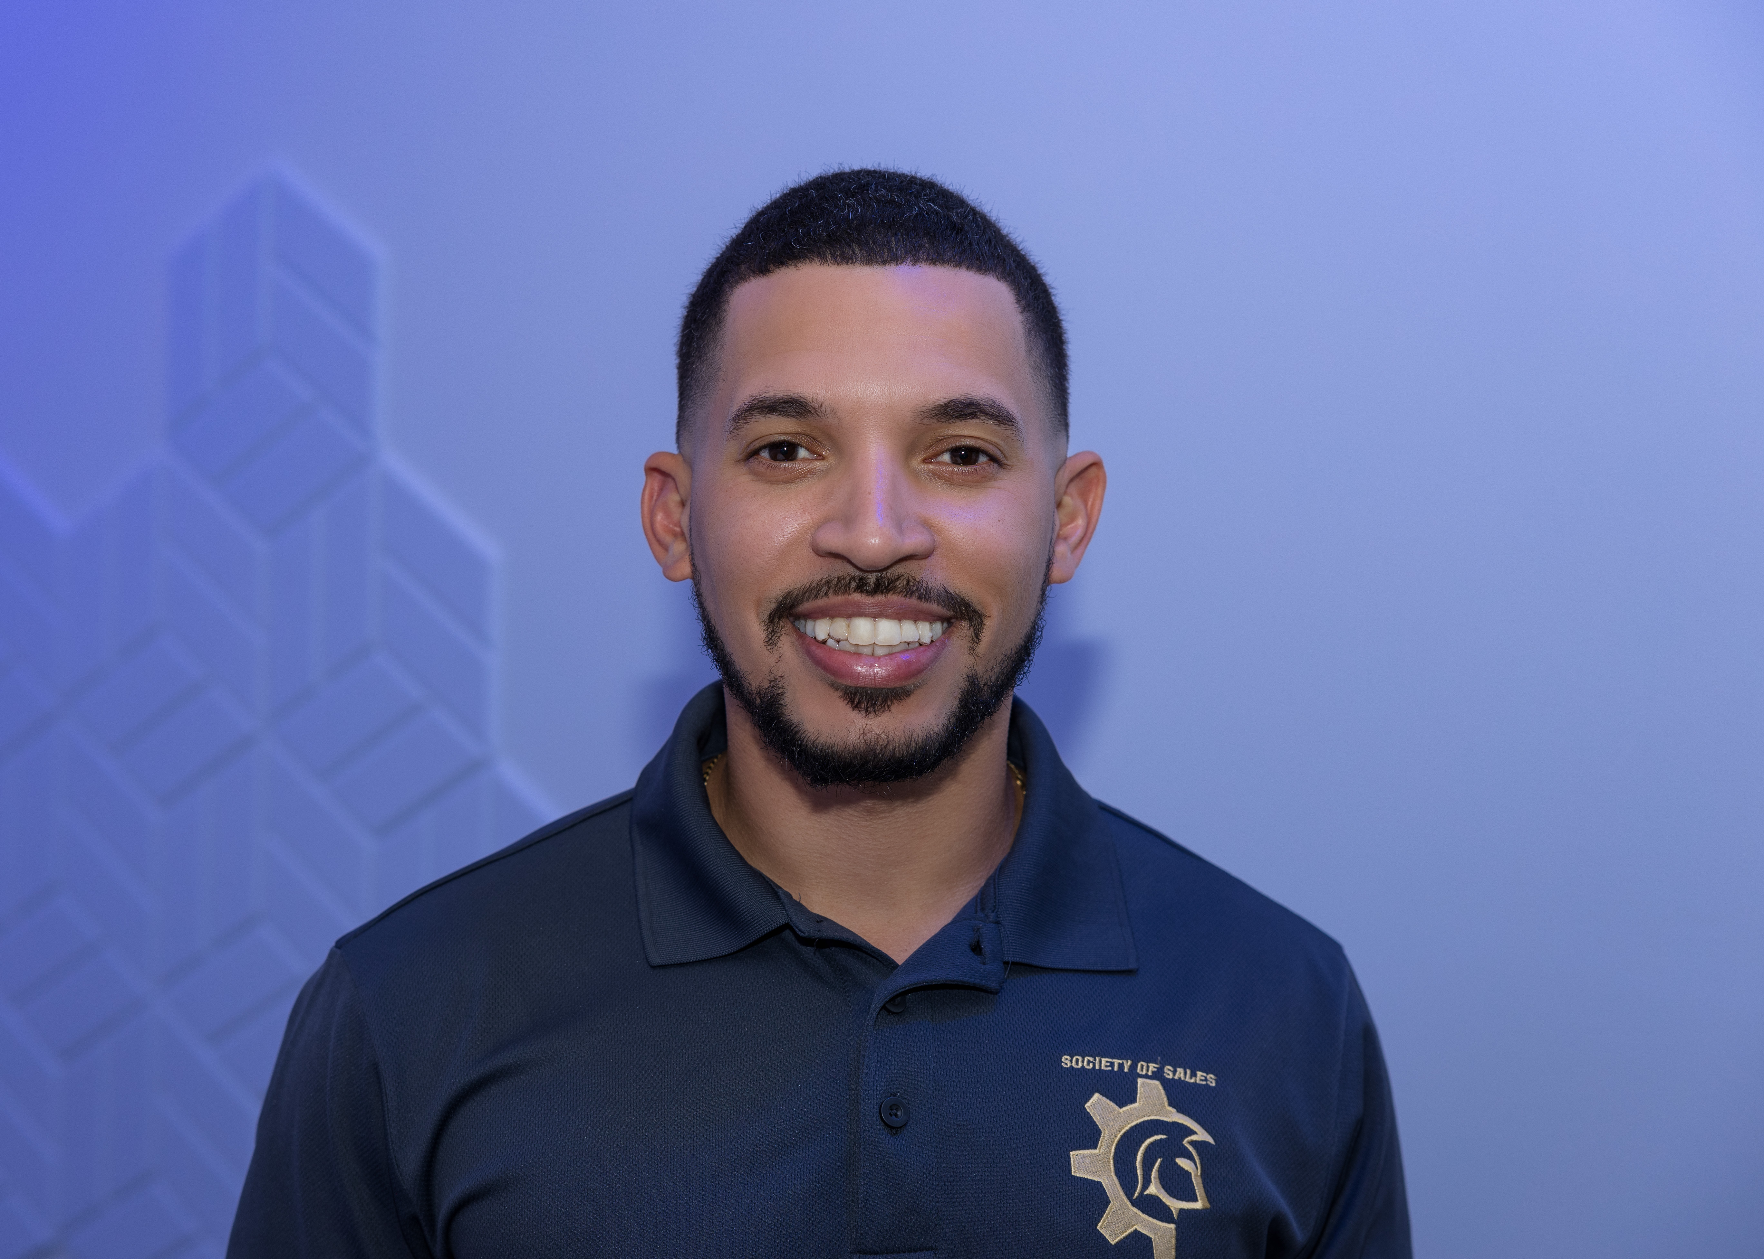

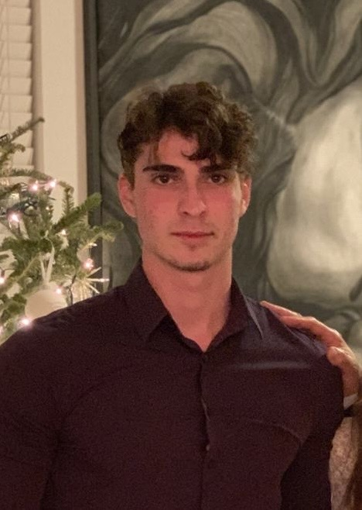
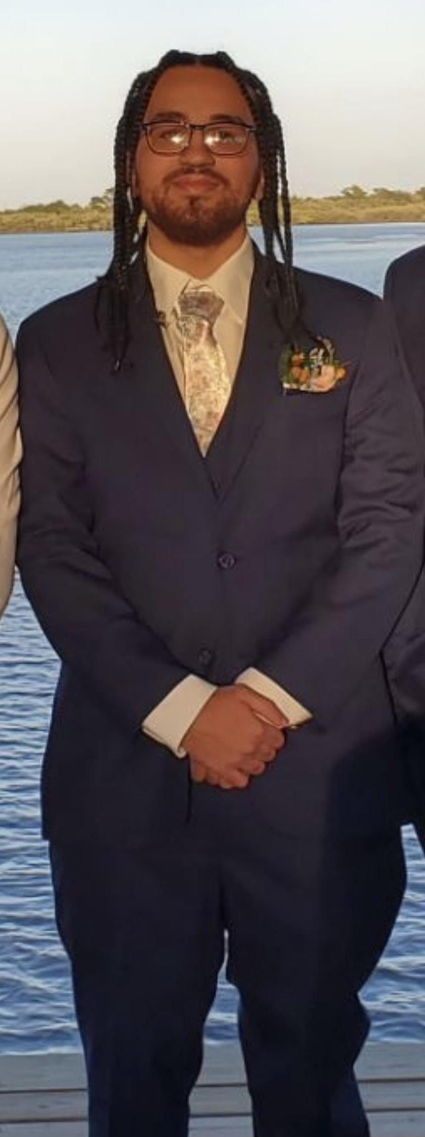

Meet The Team
Mario Puesan
PSE
Mary Bartlinski
CPE
Sean Waddell
EE
Andre Reveles
CPE
Luis Hernandez
CPE
Notes:
Mario
Meet the team

Slide 3
Motivation & Background
Marine debris and waste improperly discarded beachgoers
Plastics, glass, and aluminum are some of the most harmful
Beach cleaner allows for less debris on the beaches and a healthier environment
ALiCS not only collects trash but sorts glass, plastic, and aluminum
Existing Technologies:
BeBot
iRobot Roomba
Beach Metal Detectors
Notes:
Mario
Today we’ll be discussing the importance of addressing marine debris and the impact it has on our beaches. One of the biggest problems we face is trash being left behind by people, which often ends up harming marine life and polluting the environment. Plastic bottles, aluminum cans, and glass waste can have critical effects on coastal ecosystems, including the animals and plants that depend on them.
Our project, ALiCS, was developed with this in mind. By helping to keep beaches clean, we’re not only improving the aesthetics but also promoting a healthier environment. What makes ALiCS unique is that it doesn’t just pick up trash—it’s designed to sort it. ALiCS can differentiate between glass, plastic, and aluminum, sorting them for proper disposal or recycling, all while navigating autonomously across beach terrain.
Taking a moment to look over some existing technologies that inspired or influenced our project, first, we have the BeBot, a beach cleaning robot that uses rakes to sift through the sand and remove debris. Another familiar technology is the iRobot Roomba, which, although primarily used indoors, employs smart navigation and debris collection that we’ve learned from. Additionally, beach metal detectors are often used to find valuable items buried in the sand, providing insight into how sensors can detect objects in complex environments.
While each of these technologies contributes to solving the problem of debris, they don’t yet address the complete need for sorting and navigating diverse beach conditions like ALiCS aims to do.

Slide 4
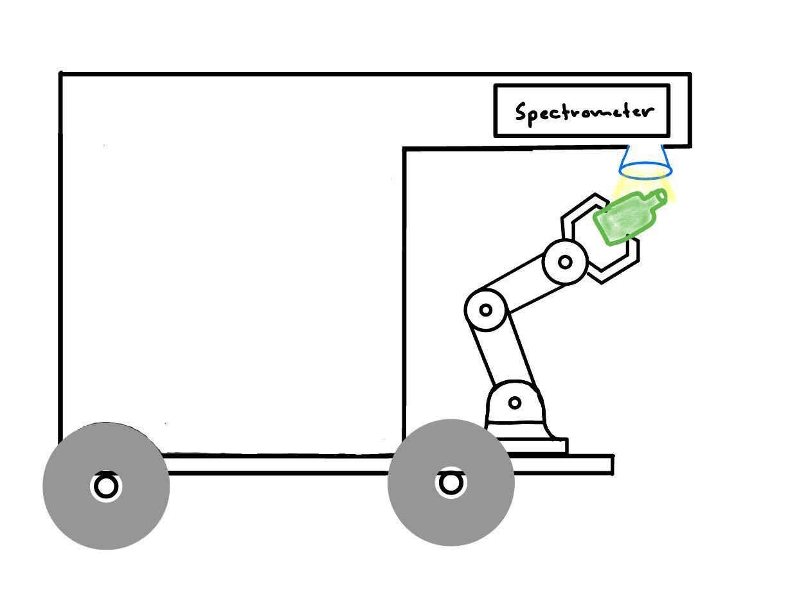

Goals and. Objectives
Identify and collect different types of trash
Aluminum cans, plastic bottles, glass bottles
Efficiency in picking up objects
Navigate across different terrains
Camera Vision and Machine Learning
Avoid obstacles that would harm the rover
Avoid bodies of water and large objects
Notes:
Mary
ALiCS will be able to identify and collect different types of trash, specifically aluminum cans, plastic bottles, and glass bottles. The system must operate efficiently, picking up debris quickly and accurately.
ALiCS also needs to navigate across a range of terrains, from sandy beaches to more challenging areas like rocky paths or gravel. To do this, we’re implementing a combination of camera vision and machine learning. These technologies will allow ALiCS to distinguish between trash and natural objects and intelligently decide which items to collect.
In terms of safety and navigation, ALiCS must avoid obstacles that could damage the rover. It will also be programmed to avoid large bodies of water and other obstructions, ensuring smooth, uninterrupted operation.

Slide 5
Specifications
Component(s) | Parameter | Specification
Meca500 Industrial Robot Arm | Payload, Reach Speed | 0.5kg 0.33m 150deg/sec
Power Supply | Discharge Time, Efficiency | TBD >80%
Spectrometer | Readout Rate Sensitivity Optical Bandwidth | 60Hz 1000 counts/(ms µW) 2.0-5.0µm
Raspberry Pi Camera | Resolution Depth of Field FOV Framerate | 8 Megapixels 10cm to ∞ 62.2 deg 24 fps
Lidar Puck | Range Field of View Power Scan Rate | 12m 360° 5v 2-10Hz
Motor (Drive) | Current Torque | 6.6A 0.33 newtons-meter
Motor (Steering) | Torque | 0.33 newtons-meter
Raspberry Pi 4 | Pinout Decoding capability Peripherals | 40 pin GPIO header 1080p60 decode, 1080p30 encode 2 USB ports 2 micro-HDMI ports Micro-SD card slot 5V DC via USB-C 5V DC via GPIO
Proximity Sensors | Range | 4-30cm
Notes:
This table outlines the key specifications of the ALiCS components: the Meca500 Industrial Robot Arm, the spectrometer, and the LiDAR puck, each selected to meet the system’s requirements.
The Meca500 Industrial Robot Arm handles object manipulation with a 0.5 kg payload and a 0.33 meter reach, offering 150°/sec speed for efficient sorting.
The spectrometer analyzes material composition, operating at a 60Hz readout rate with high sensitivity at 1000 counts per millisecond per microwatt (ms µW), and an optical bandwidth of 2.0-5.0 micrometers µm, ideal for identifying plastics, glass, and aluminum.
The LiDAR puck is crucial for navigation, offering a 360° field of view with a range of up to 12 meters. It scans at 2-10Hz and operates efficiently on 5 volts, suitable for low-power designs.

Slide 6
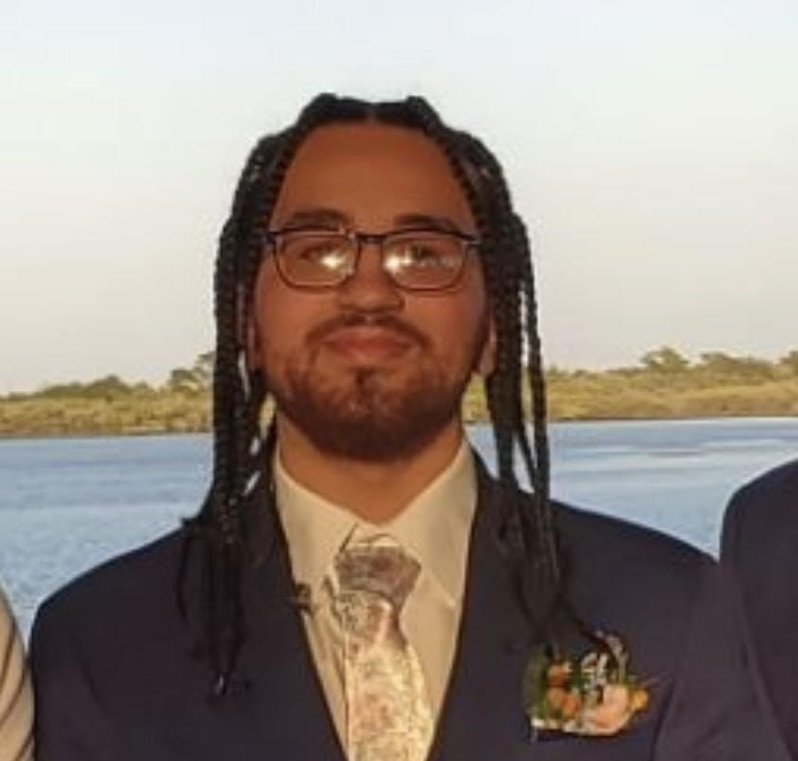
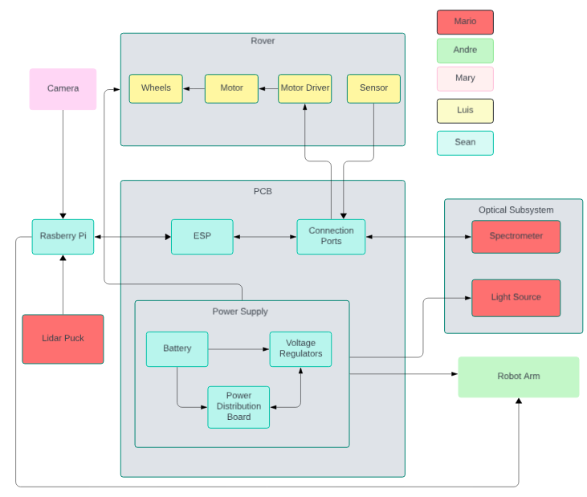

Hardware Diagram
Notes:
Luis, this is the hardware diagram, as you can see in the top right is our key and it shows who is responsible for which component. Mary will be working on the camera, I will be working on the rover section, Sean will be working on the PCB and power supply section, Mario will work on the optical section and andre will work on the robot arm

Slide 7
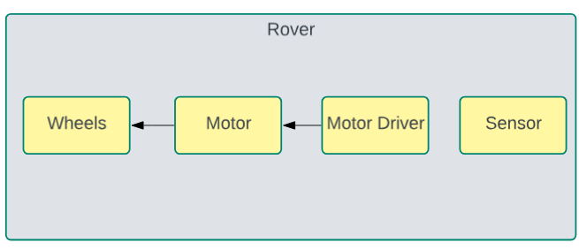
Rover
When it comes to the functionality of the rover, there are four main components, the wheels, the motor, the motor driver, and the sensor
Notes:
Luis, I am in charge of the rover section and (READ THING) in the image to the right, you can see how these components work together

Slide 8
Types of Wheels
 | Balloon Wheels | Standard Wheels | Omni Wheels
Movability | Forwards and Backwards | Forwards and backwards | Moves in all directions
Height | Around 9-12 inches | Ranges from 2-18 inches | Around 4-7 inches
Material | Polyurethane, rubber, PVC, | Rubber | Plastic and Rubber
Off Roading Capabilities | Strong | Good | Poor
Cost | High | Moderate | Low
Notes:
Luis, The first component I will talk about is the wheels, We were deciding between three main types of wheels, the baloon wheels, standard wheels, and omni wheels. it is important to consider our enviorment and the fact that our design will need to operate in the sand, so it will need to be have good off roading capabilities as well as be tall enough to avoid kicking up sand near our components. Although the cost might be a bit detrimental to our budget, I went for the best option which is the baloon wheels

Slide 9
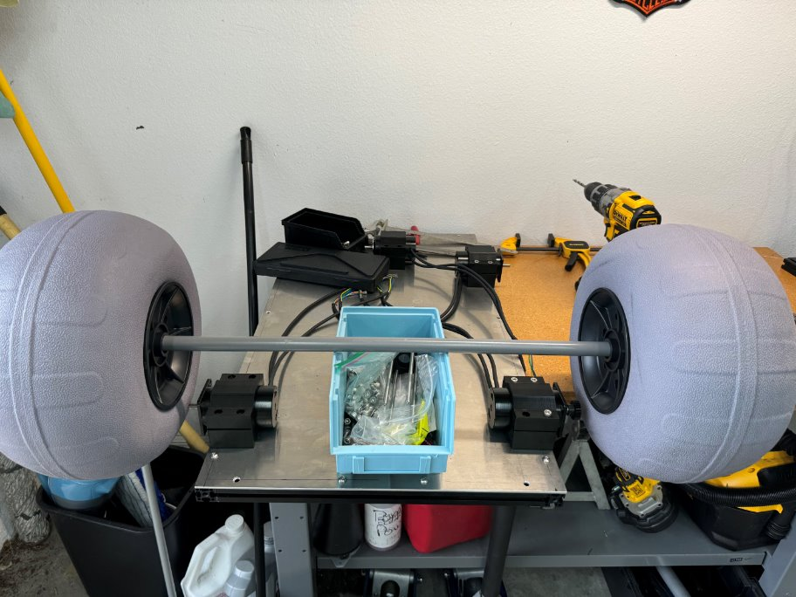
Balloon Wheels
 | Wheeleez | VEVOR Wheels | Extreme Max Wheels
Weight | 1.5 pounds | 6 pounds | 3.85 pounds
Diameter | 9.4 inches | 13 inches | 11.3 inches
Material | Polyurethane | PVC | Not Listed
Cost (Per Wheel) | $70 | $30 | $45
Notes:
Luis, When it comes to balloon wheels, there are three specific wheels we were considering, the two deciding factors of the wheels was the price as well as the diameter. Of the three options, one of them had a diameter bigger than the other two as well has having a cheaper price and that was the VEVOR Wheels. The image in the right is how the VEVOR wheels look like.

Slide 10
Motor
 | Brushed DC Motor | Brushless DC Motor | Stepper Motor
Torque | Reaches maximum torque at certain positions | Constantly reaching maximum torque | Does not reach its maximum torque
Power Usage | Moderate | Moderate | High
Cost | Low | Moderate | Low
Notes:
Luis, Now its time to talk about the second component of the rover, the motor, there are three main types of motors that were considered and they are the brushed DC motor, the brusheless DC motor, and the stepper motor. The main thing we are looking for in our motors is torque, we want to make sure that our motors are capable of moving our design without having issues, and for that we would need to have a motor that is capable of reaching its max torque. TheBrushed DC motor does it at certain positions, the stepper motor does not reach max torque, but the brushless DC motor is constantly reaching its maximum torque which is why it is a solid option

Slide 11
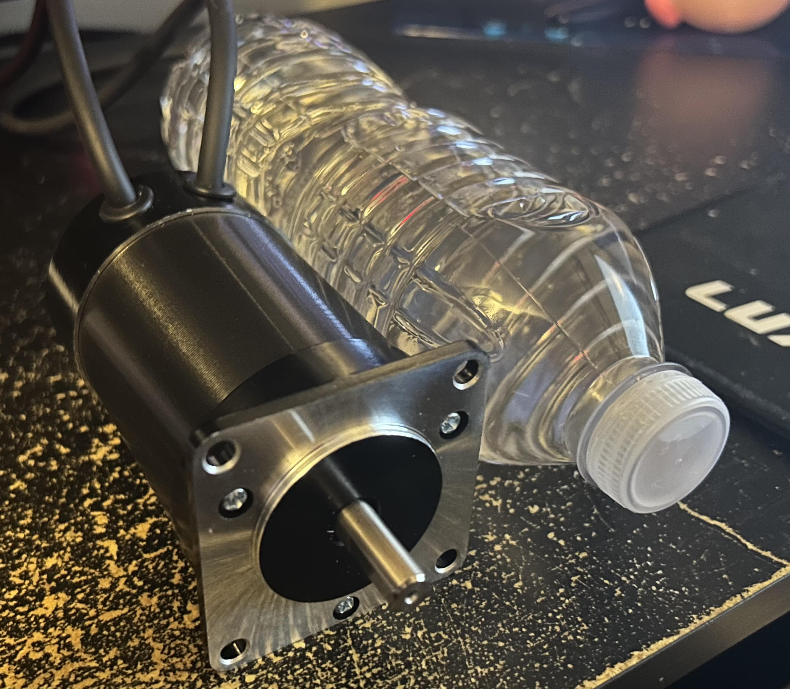
BLDC Motor Choice
 | 57BLF03 | ESMO-01F | TEC4260
No-Load Speed | 3000 rpm | 8000 rpm | 5000 rpm
Voltage | 24 Volts | 24 Volts | 12-24 Volts
Rated Current | 6.6 amps | 2.5 amps | 2.5 amps
Torque | 3365 grams-centimeter | 700 grams-centimeter | 500 grams-centimeter
Cost | $36.00 | $24.85 | $27.99
Notes:
Luis, Now its time to compare the three choices for the BLDC motor. The no-load speed of the motors is not too essential since as mentioned before, we are mainly interested in high torque to carry our design. The voltages of the motors are around the same range. The outlier in the current is the 57BLF03, but the main reason is that the 57BLF03 has a way higher torque compared to the other two options, and for that reason, we are choosing the 57BLF03. The image shown is how the 57BLF03 motor looks like compared to the size of a water bottle

Slide 12
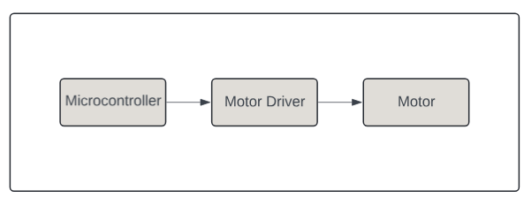
Motor Driver
The purpose of a motor driver is to provide the necessary power in order to drive a motor. The only choices we have for motor drivers are the ones that are compatible with a brushless DC motor
Notes:
Luis, Here we have the third component of the rover, the motor driver. (READ SLIDE) the diagram on the right is there to illustrate where the motor driver would operate. you can see that the motor driver is essentially the bridge to connect the microcontroller to the motor

Slide 13
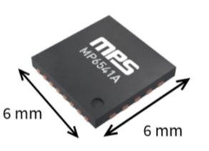
Motor Driver Choice
 | L6230Q | MP641A | MCF8315C
Works with BLDC Motor? | Yes | Yes | Yes
Pins | 40 Pins | 26 pins | 40 pins
Max Voltage | 52 Volts | 45 Volts | 40 Volts
Peak Current | 2.8 Amps | 8 Amps | 4 Amps
Size | 5 mm x 5 mm | 6 mm x 6 mm | 7 mm x 5mm
Cost | $2.88 | $8.77 | $1.44
Notes:
Luis, Here we have the 3 options of the motor driver, These three motor drivers are compatible with BLDC motor which is good, but there are two main requirements we are looking for, one is that motor driver should have a max voltage higher than the motor so that it can supply it as well as it should have a higher peak current than the motor in order to supply it. In our case, the 57BLF03 has a voltage of 24 volts, which is lower than all three motor drivers, but it has a current of 6.6 amps, which the only motor driver that is higher than that is the MP641A which is our choice.

Slide 14
Types of Sensors
 | Ultrasonic | Active Infrared | Passive Infrared
Wave Direction | Travels to and from sensor | Travels to and from sensor | Only travels from sensor
Able to determine Distance | Yes | Yes | No
Minimum Detection Range | Around 2 cm | Around 20 cm | Around 3 cm
Power | 3.3 - 5 Volts | 3 – 5.3 Volts | 3.3 - 5 Volts
Price | Low | Low | Very Low
Notes:
Luis, Now for the fourth and final component of the rover, the sensor. The sensor's only goal is to act as a failsafe and what It would do is that if it detects an object that is very close to our design it would stop any movement immediately to prevent colission. This would mean that we would need a sensor that can determine distance and also has a small detection range so it can detect objects that are close. With that beign said, I believe that the ultrasonic sensor would be our best choice

Slide 15
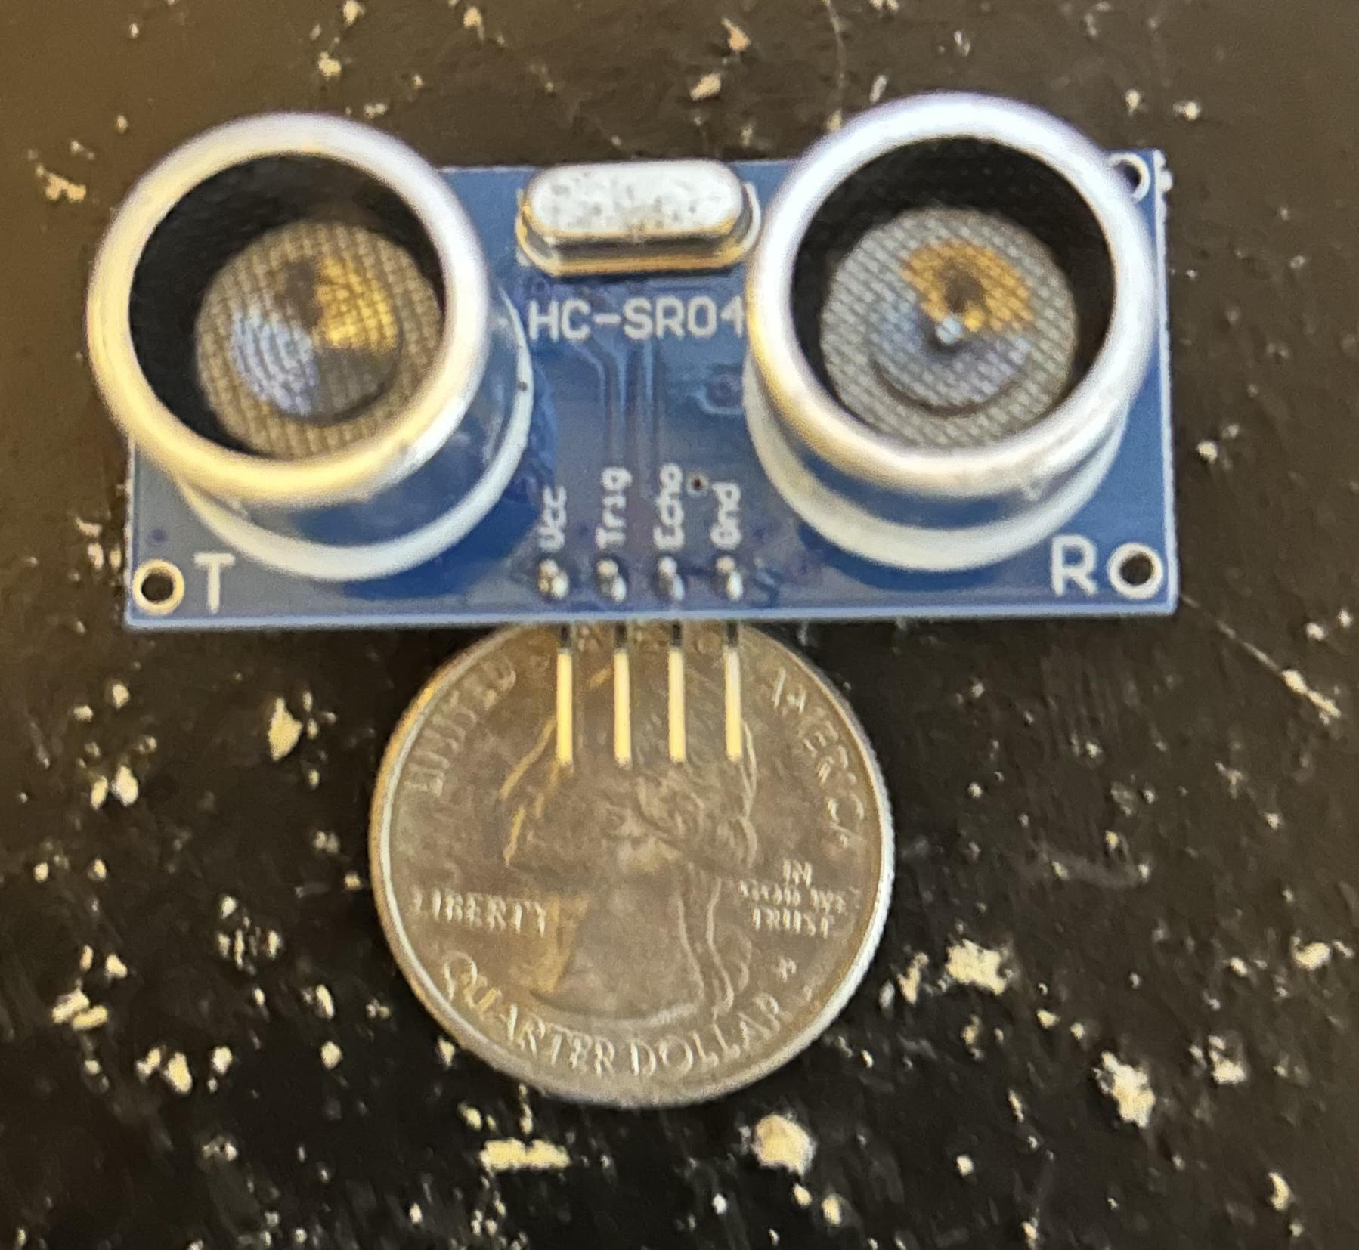
Ultrasonic Sensors
 | HC-SR04 Sensor | MB1232 I2CXL Sensor | MA40S4S Sensor
Detection Range | 2 – 400 cm | 20 – 765 cm | 30 –250 cm
Voltage | 5 Volts | 3 – 5.5 Volts | 1.7- 3.6 Volts
Measure Angle | 30° | Not listed | 80°
Price | $4.50 | $39.95 | $5.44
Notes:
Luis, Here we have a table comparing 3 different ultrasonic sensors. The main concer of the sensor is the detection range, we want the range to have a small minimum number because we want to detect if objects are TOO close, so with that being said, the HC-SR04 is the best choice along with the fact that we are more familiar with that sensor as well.

Slide 16
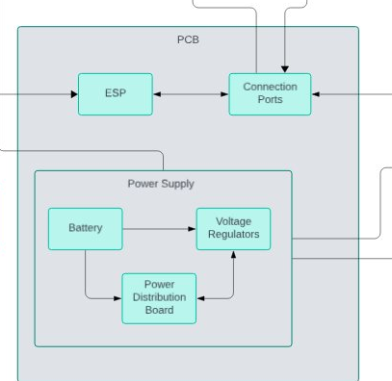
PCB
The PCB will house the microcontrollers, external connection ports, and the power supply.
The power supply will consist of the battery, voltage regulators, and the power distribution board
Notes:
Sean

Slide 17
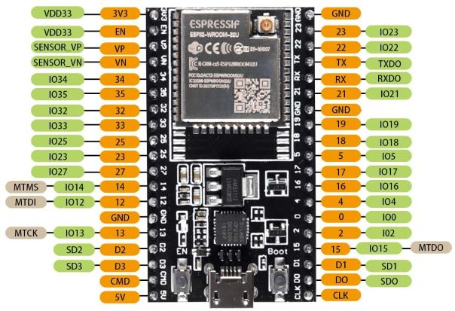
Microcontrollers
ESP32 WROOM
Purpose: ESP will instruct the motors to start/stop
Uses less voltage than most MCUs and is power efficient.
Multiple connection peripherals and GPIO pins
Processor | Two low-power Xtrensa 32-bit LX6 microprocessor
Clock Speed | 80 MHz to 240 MHz
Voltage | 3.6V
Current Draw | 0.379A
Power Consumption | 1.3644W
Memory | 4MB
RAM | 520KB
Cost | $9
Notes:
Sean

Slide 18
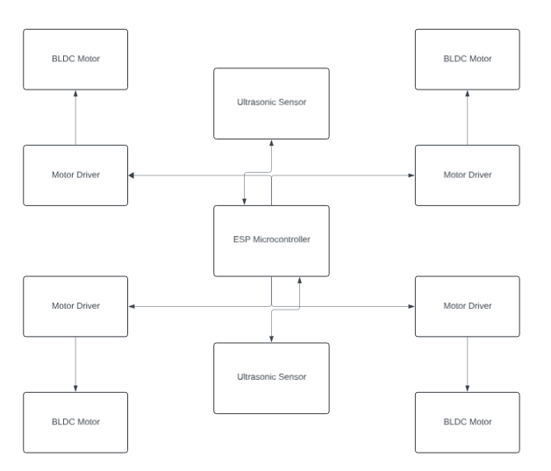
Redesigned ESP32
Purpose: The ESP32 needs to be able to connect with the motor drivers to steer and control ALiCS
It also needs to receive the data from our ultrasonic Sensors
Notes:
Sean

Slide 19
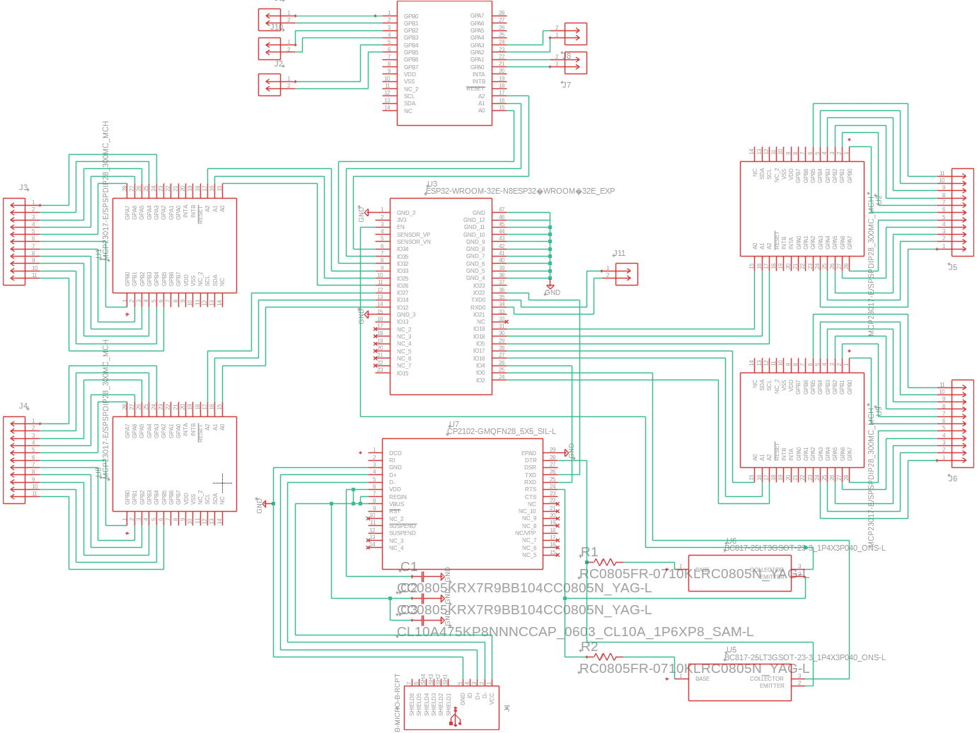
Redesigned ESP32
Notes:
Sean

Slide 20
Motor Board
To connect the motor drivers, we put them on a separate board that would be easier to take parts on and off in case one of the motor drivers were to break or burn up.
This board will have direct connections from the Power Distribution Board and the ESP32 that will control and power the motor driver.
This board will also send the different phase signals to the DC brushless motor to give it the correct information on where to go.
Notes:
Sean

Slide 21
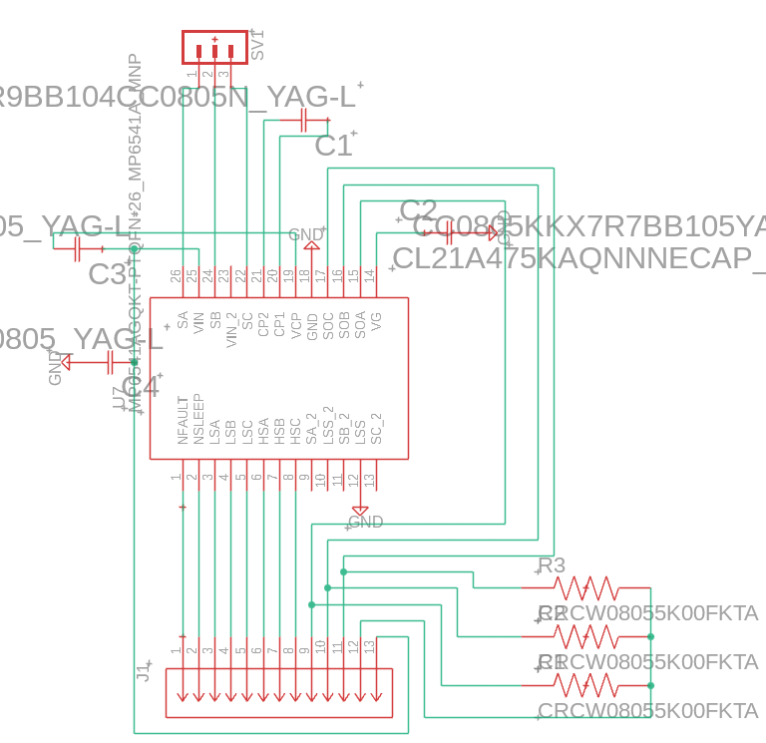
Motor Board
This is one of four of the motor drivers connected on the board with the exact same pinout for every motor driver
Notes:
Sean

Slide 22
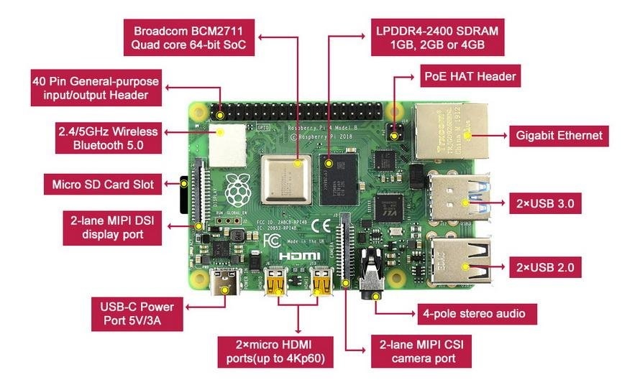
Microcontrollers
Raspberry Pi 4 Model B​​
Purpose: Raspberry Pi will collect camera data and transmit data​​
Comes with 4GB of LPDDR4 RAM and built-in video chip supporting 3D graphics​
Multiple peripherals including a direct port to the Raspberry Pi Camera​
Processor | Quad core 64-bit A72 Processor
Clock Speed | 1.5 GHz
Voltage | 5V
Current Draw | 3A
Power Consumption | 3-5W
Memory | 4GB
RAM | 4GB
Cost | $55
Notes:
Sean

Slide 23
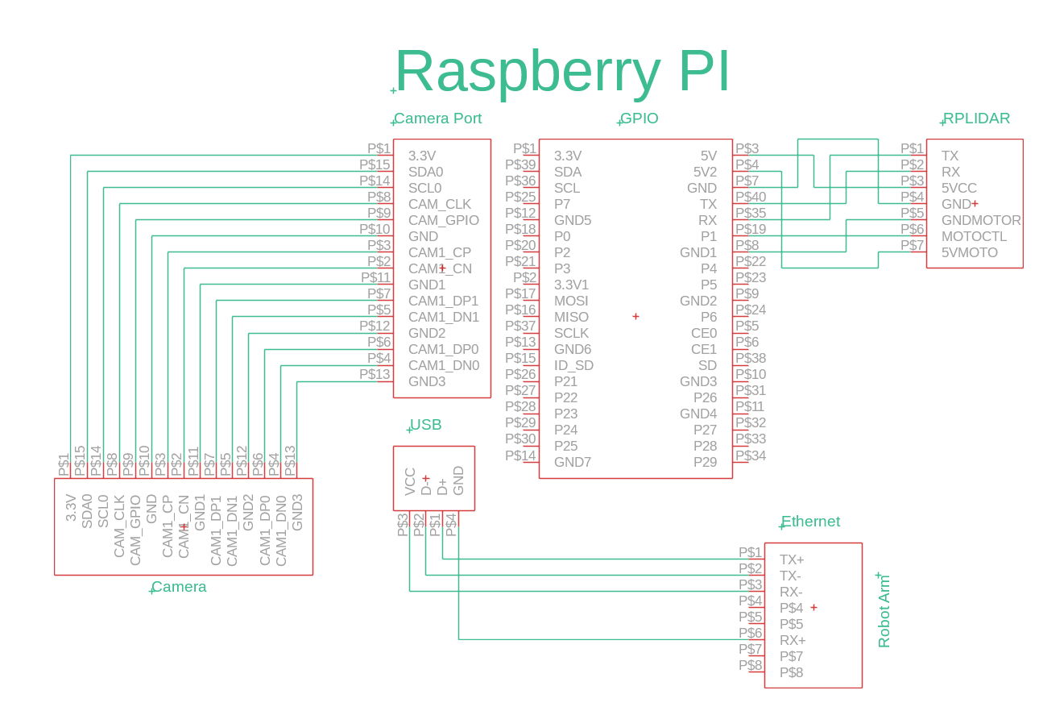
Raspberry PI
Purpose: The Raspberry Pi will power our camera, lidar, and our ESP32. The Raspberry Pi will also control the Robot Arm.
This board will communicate information with our ESP32 and let the ESP32 decide what action to do depending on what information is sent to the ESP32.
Notes:
Sean

Slide 24
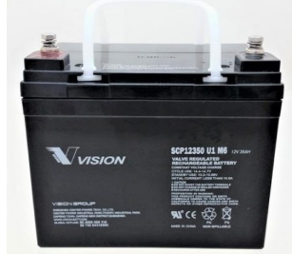
Battery
Purpose: The battery is two 12V batteries in series to make a 24V battery with 35Ah. This battery should power our whole device while lasting a long time with doing its purpose
Notes:
Sean

Slide 25
Voltage Regulators
Purpose: to regulate/control the voltage a specific part can withstand
Switching Voltage Regulators—for its flexibility and high efficiency
Parameters | Linear Voltage Reg | Switching Voltage Reg
Type | N/a | Buck | Boost | Buck-Boost
Efficiency | Medium | High | High | High
Voltage output | Step-Down | Step-Down | Step-Up | Step-Down/up
Heat | Medium | Low | Low | Low
Output Ripple | Low | Low | High | Low
Notes:
Sean

Slide 26
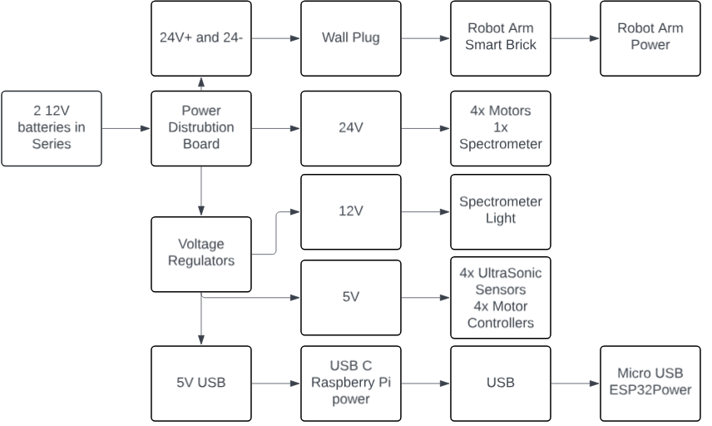
Power Supply
Purpose: This board is specifically constructed to deliver the precise voltage required by various components ​
Accommodates 2-wire connections to wall outlet for robot arm​
Includes a USB port to efficiently power devices such as the Raspberry Pi and ESP32.​
Power Supply Block Diagram
Notes:
Sean

Slide 27
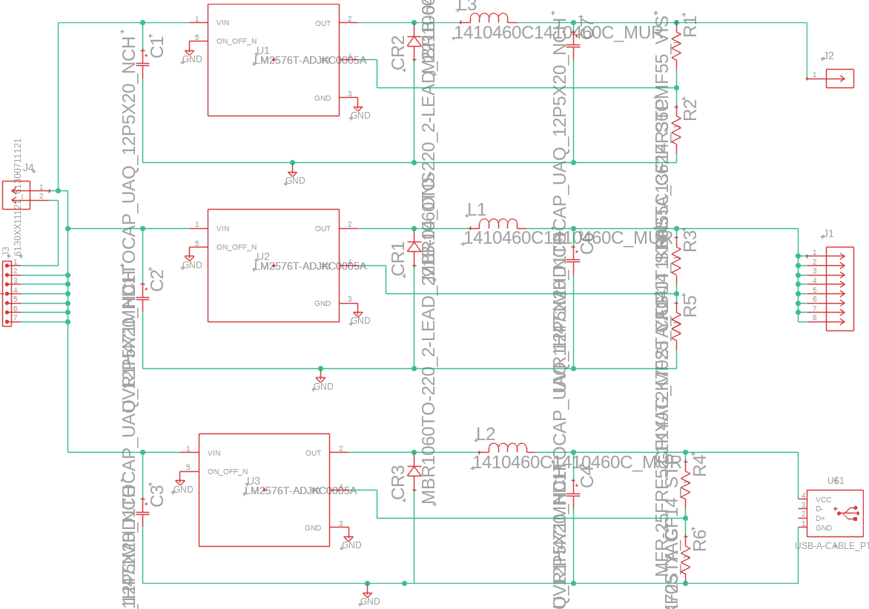
Power Supply Schematic
Notes:
Sean

Slide 28
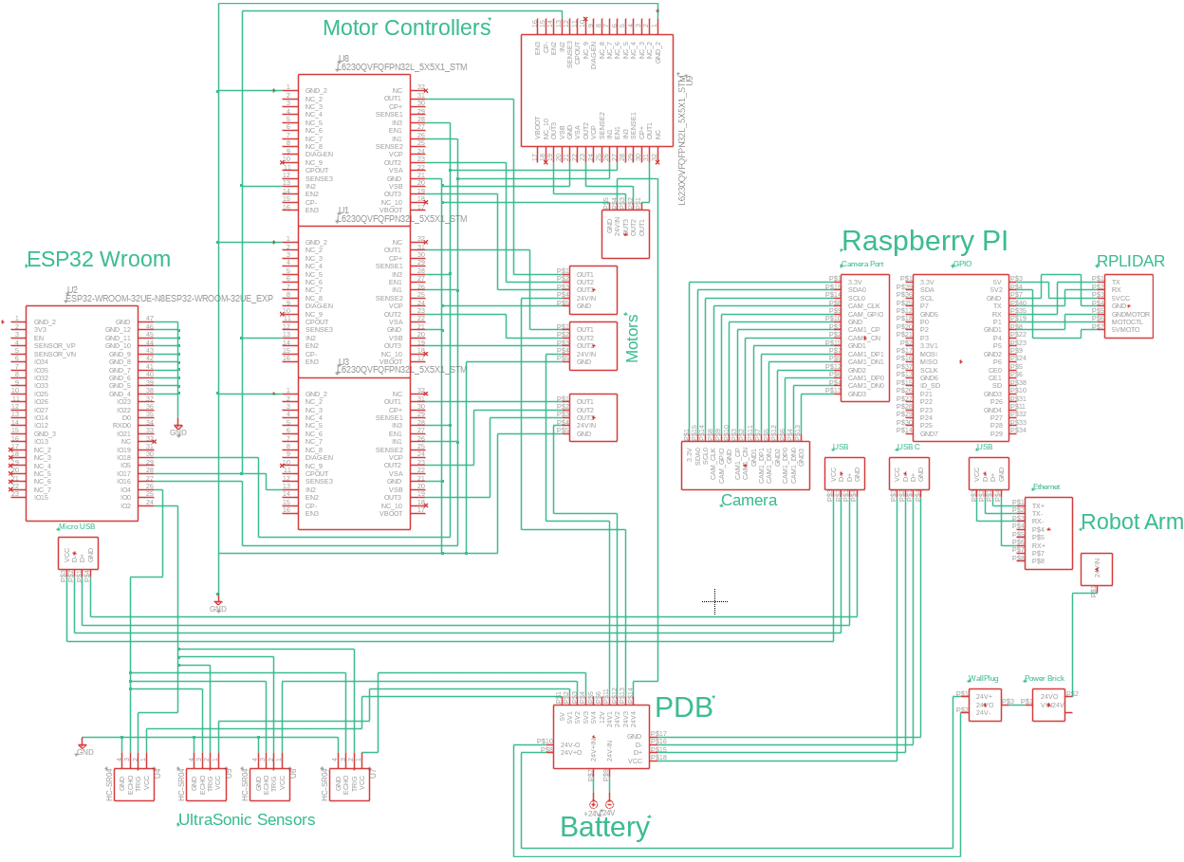
Overall Schematic
Notes:
Sean

Slide 29
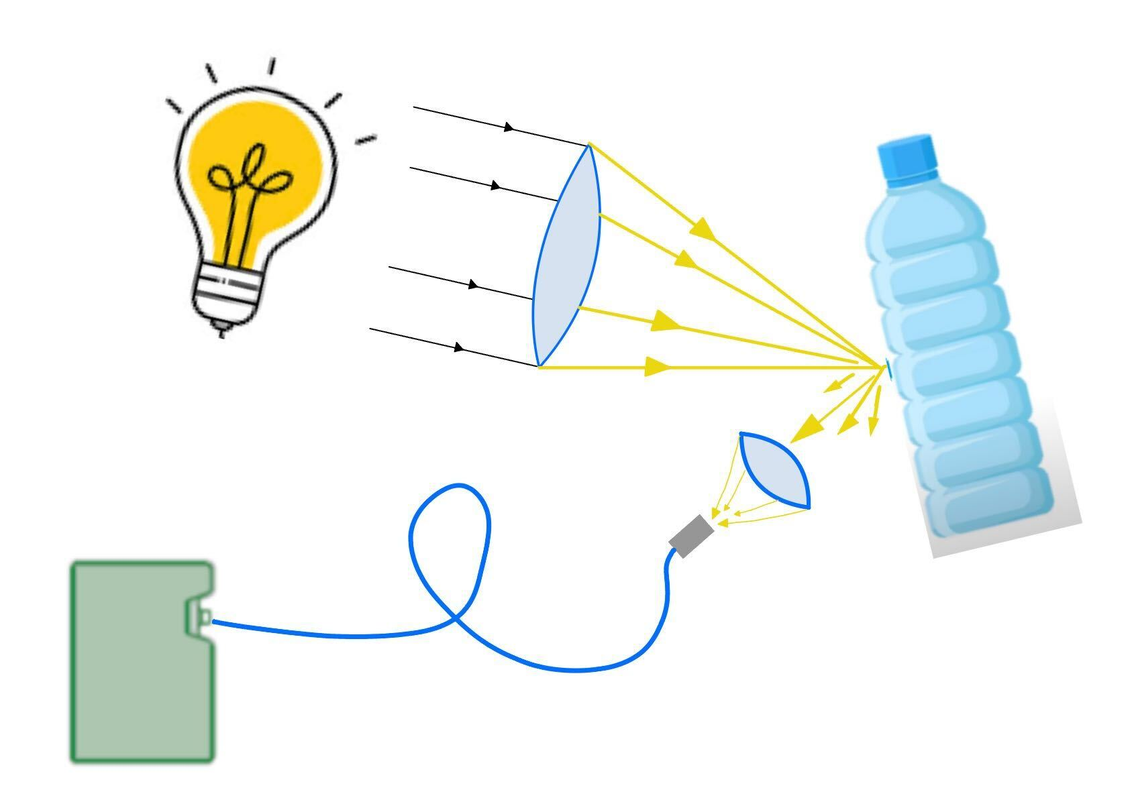
Optical System
NIR Spectroscopy (900 to 1650nm) diffuse reflection measurements
Powerful method for identification and classification
Measure reflected wavelength to quickly identify samples
Effectively automate sorting while collecting waste
Minimize impact of pollutants on the beach and in waste management
Notes:
Mario
Because NIR Spectroscopy analysis provide useful information about material characteristics including chemical composition, it is an effective technique in identifying plastics, glass, and metals for recycling.
We can think of each material having its own "finger print" once we assign the fingerprint to sample, the spectrometer can communicate to the MCU to determine what the collected sample is.
We plan to implement an "in-process" system that actively sorts waste while collecting from beach environments.
The optical system of our design will consist of - A Halogen/Tungsten light source, that emits from visible well into the Infrared spectrum
A focusing lens that will give us higher peak density or concentration of light on to the sample
Once light is reflected from the sample on to the returning focusing lens it will pass through a bandpass filter to remove undesired wavelengths and focus on to input of the optical fiber
The optical fiber will carry the reflected light from the sample to the entrance slit of the spectrometer

Slide 30
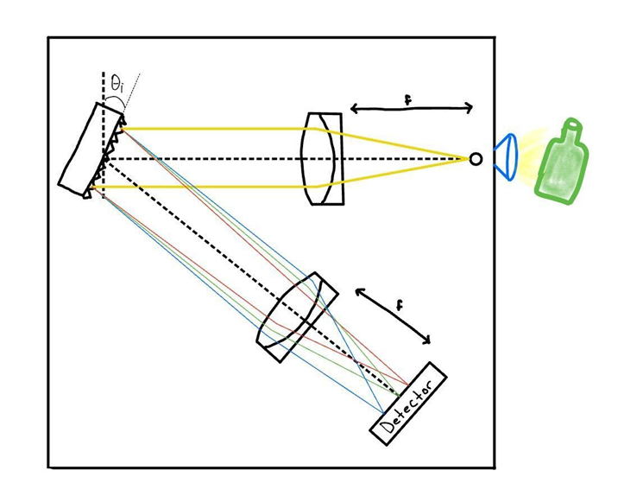
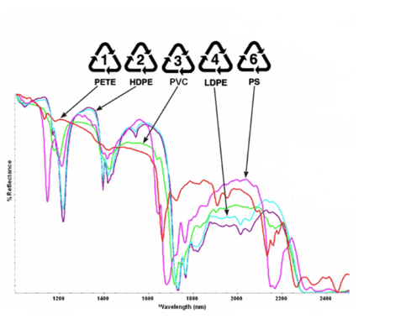
Optical System - Spectrometer
Reflected wavelength is dispersed and measured by detector
Read out from Spectrometer to MCU and compared to reference samples
MCU will be determine which bin to place the sample in determined by spectra
Notes:
Mario
This is the bread and butter of the optical system design, once the reflected light passes through the entrance slit of the spectrometer, it will be collimated on to the diffraction grating.
The diffraction grating will then separate or disperse reflected light into constituent wavelengths, through the focusing mirror and on to the linear array detector.
This detector is sensitive to NIR wavelengths will be able to profile the reflected wavelengths to decide whether the sample is plastic, aluminum, or glass.
Here we see, on the bottom image, the spectra of some previous collected plastics. Even though these 5 samples have very similar spectra, they are still very unique and can be identified by NIR Spectroscopy.

Slide 31
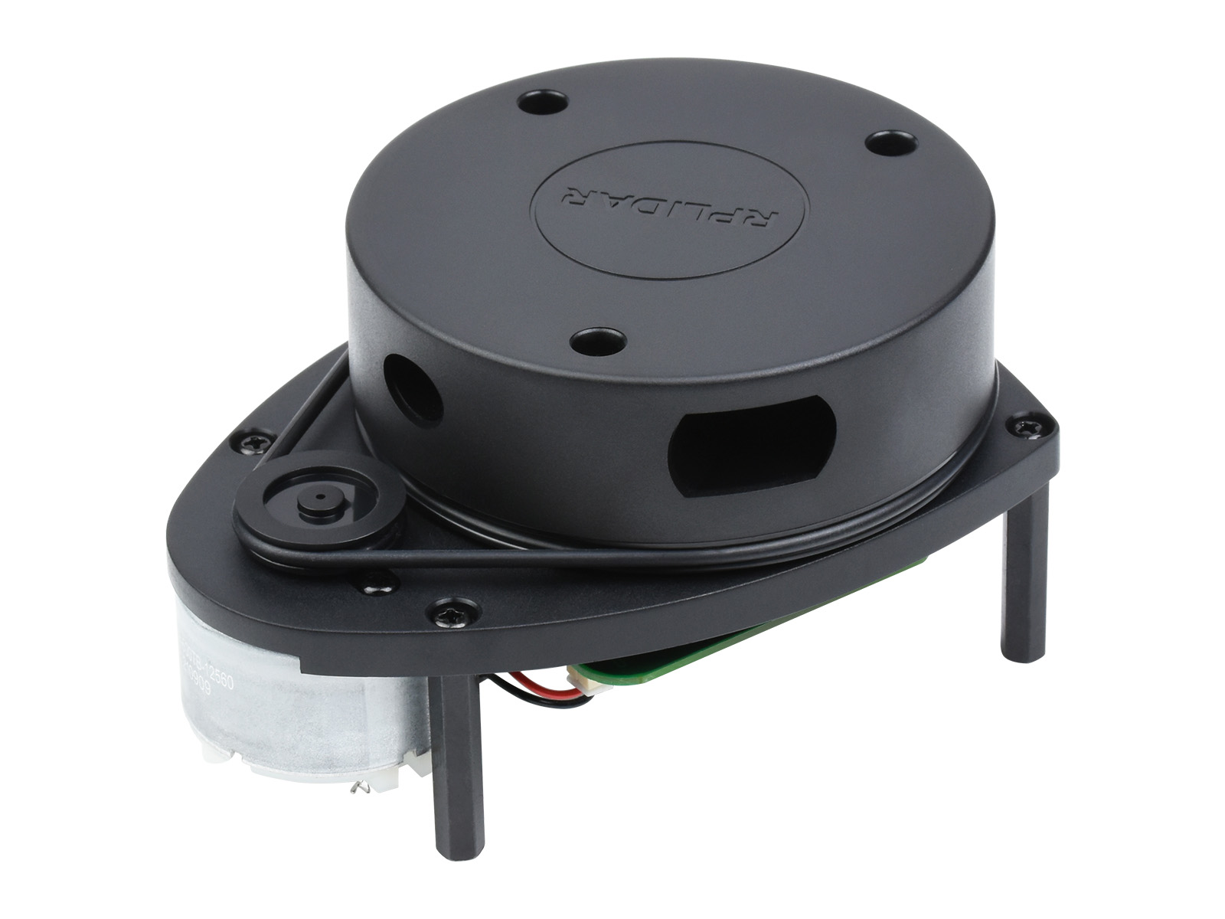
LiDAR
360 Degree 2D scanner
Plug & Play capability with range of 12 m
Compatible with ROS & open-source hardware
 | Slamtec RPLiDAR | Yahboom EAI X3 | Inno Maker LD06
Scan Range | 12 m | 8 m | 12 m
Sampling Frequency | 8000 Hz | 3000 Hz | 4500 Hz
Scan Rate | Up to 10 Hz | Up to 10 Hz | Up to 13 Hz
Distance Resolution | ≤ 0.5mm | ≤ 0.5mm | ≤ 0.5mm
Wavelength | 785 nm | 775 – 800 nm | 780 – 800 nm
Price | ~$100 | ~$100 | ~$100
Notes:
Mario

Slide 32
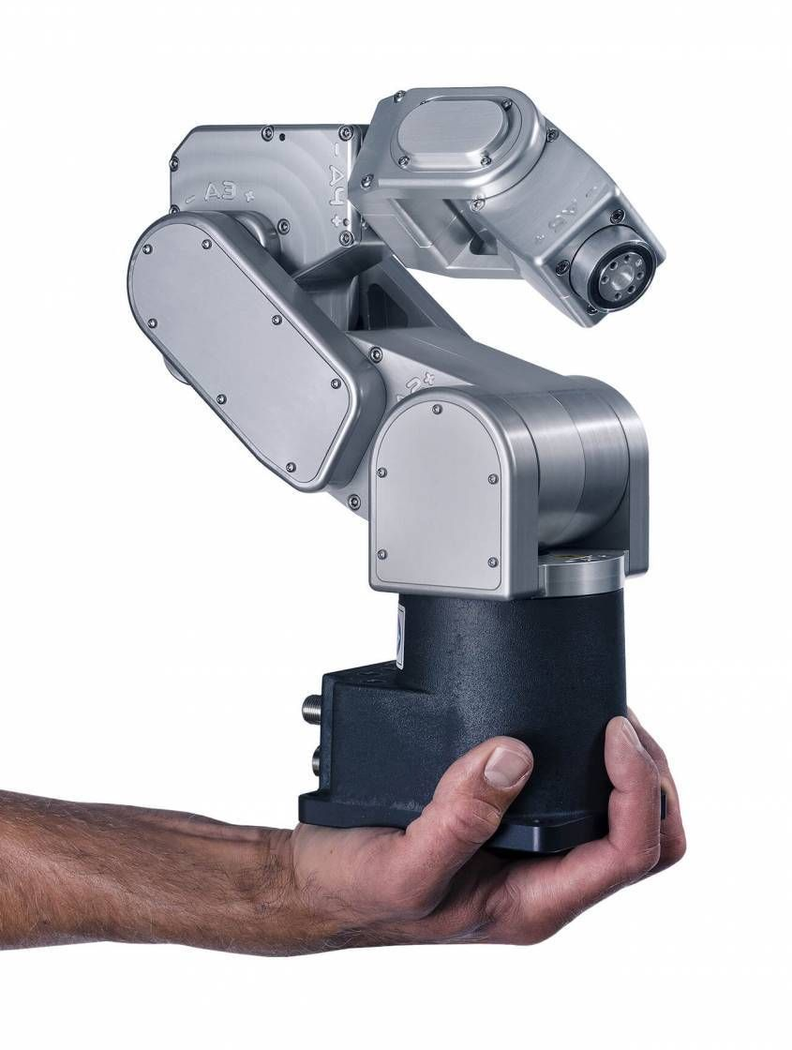
Meca500 Robot Arm
Compact and moves in any direction
Will move and hover over trash
Own programming API
 | Meca500 | MechArm | UFactory xArm 5
Payload | 0.5 kg | 0.25 kg | 3 kg
Reach | 330 mm | 270 mm | 700 mm
Position Repeatability | 0.005 mm | 0.5 mm | 0.1 mm
Degrees of Freedom | 6 | 6 | 5
Weight | 4.3kg | 1kg | 11.2kg
Price | High | Low | High
Notes:
Andre
For the robotic arm, there are several viable options. The relevant specs we want to focus on are the reach, weight, and position repeatability.
While all great options, Mecademic’s Meca500 ease of use, reach, compact size and state of the art accuracy, deem it the winner. Realistically, if we were choosing to purchase any of these three robot arms, they would end up being too pricey to be within our budget. Thankfully, we were able to get the Meca500 loaned to us by Mario's team at Luminar.

Slide 33
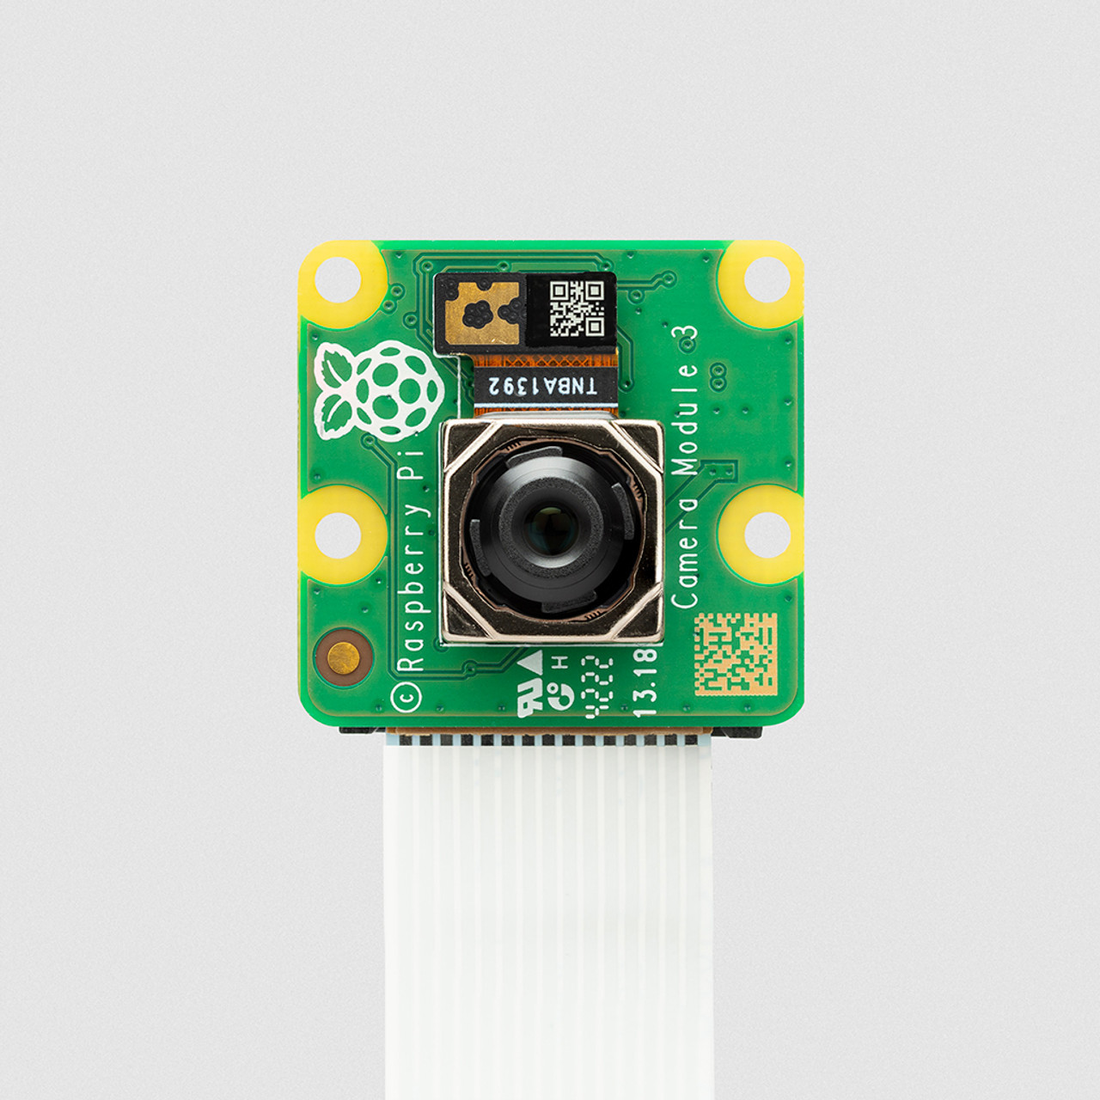
Raspberry Pi Camera
Compatibility with Raspberry Pi
Own driver support making it easy to set up and have better performance
Model 3-high resolution
Perfect size, low cost
Specifications | Raspberry Pi Camera | Logitech C920 Webcam | Arducam 8MP Camera
Resolution | 8MP | 2MP | 8MP
Focus Type | Fixed | Automatic | Fixed
Field View | 62 degrees | 78 degrees | 76 degrees
Cost | $ | $$ | $$$
Notes:
Mary
For choosing a camera, we went with the Raspberry Pi camera for its compatibility, resolution, and size. Since we are using a raspberry pi microcontroller, it would make the most sense to choose the raspberry pi camera for its compatibility. Not only does it have its own driver support, making it easy to set up, it is specifically designed for the raspberry pi. This camera offers high resolution which is crucial for image capture and sorting. With its compact size and affordable price, we decided that the raspberry pi camera would be the best option for ALiCS.

Slide 34
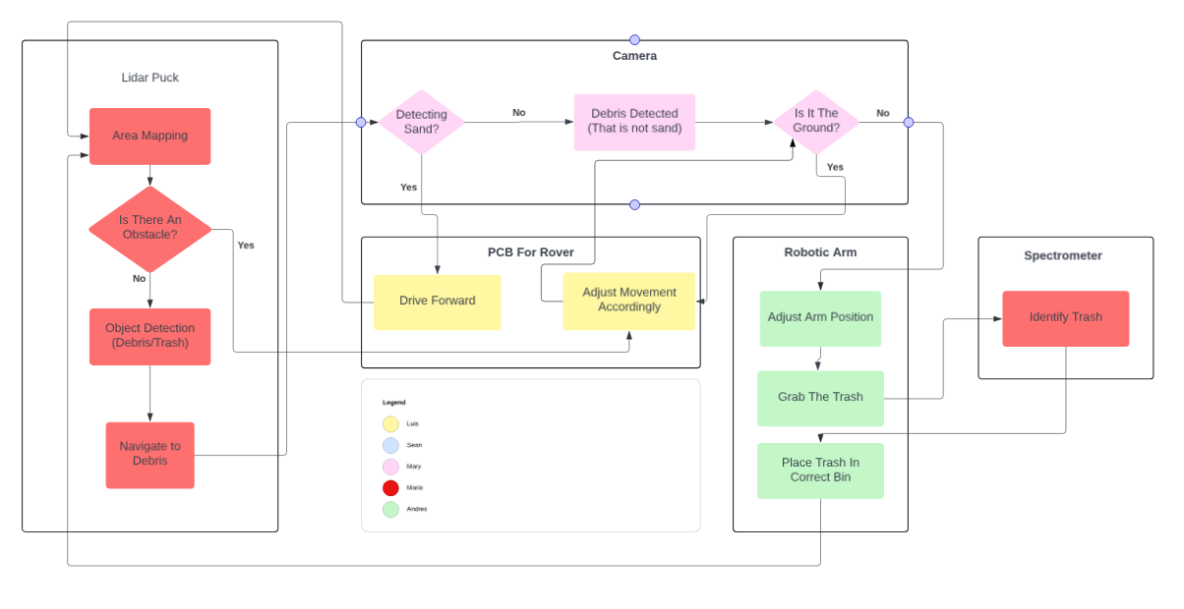
Software Diagram
Notes:
Andre
The software diagram attached represents each module our hardware components take care of. The Lidar puck is in charge of area mapping, the camera detection, The PCB software handles the rover’s driving movements. the robotic arm software will handle the positioning and trash collection, and finally the spectrometer identifies the type of trash.

Slide 35
Framework
Feature | ROS | YARP | ZeroMQ
Primary Use | Robotic middleware strictly for robot software development | Robotics middleware—modality | High-Performance messaging library—general use
Data Handling | Support complex data through topics | Efficient with data streams and interfaces | Lightweight and fast for raw data
Learning Curve | Depends on complexity | Moderate | Relatively Easy
Use Case in ALiCS | Ideal for complex robotic integration | Useful for modular, distributed systems | Best for lightweight, high-speed data
Notes:
Andre
Out of these three frameworks ROS will be the best option due to its sole purpose of robot integration and development. ZEROMQ is also a great option as it is very easy to use and useful for lightweight and high-speed data

Slide 36
Robot Operating System (ROS)
Open-source framework that provides a set of libraries and tools to develop, deploy, and test robotic systems
ROSlaunch, ROStest & RViz
Customizable and adaptable for various robot projects
Language support for Python, C, C++, and more.
Applications in ALiCS:
Will serve as the backbone of the control system, managing communication between the external entities and navigation system.
Can simplify integration of different modules such as SLAM and object detection.
Notes:
Andre
Within ROS, there are some functions of ROS that we will mainly be focusing on, because they will help us greatly with what we plan on designing. The first one is roslaunch and it is basically the main function of ROS, anything that we use from ROS will all fall under roslaunch. Rostest is another function that allows us to test any kind of ROS node and we can also test multiple nodes at the same time. RViz is a tool we can use that will help visualize what our software is displaying.

Slide 37
Mapping and Detection
Feature | SLAM | SfM | QGIS 3
Primary Use | Real-time mapping and localization in Robotics | 3D model reconstruction from images | Geographical Information System for mapping
Key Features | Real-Time operations, integrating multiple sensors | High-Resolution 3D models from overlapping images | Supports a wide range of GIS functions
Use Case | Autonomous vehicles, drones, robotics | Topographic mapping where detailed 3D models needed | Urban planning, environmental management
Data Handling | Processes sensor data in real-time using LiDAR, Cameras, etc | Uses Image data | Handles spatial data in various formats
Notes:
Mary
Here, we are looking at 3 different technologies for mapping and detection. SLAM technology excels in real-time mapping and localization, integrating sensors and cameras which is essential to ALICS. Looking at use cases, SLAM is widely used in autonomous vehicles, drones, and robotics. SfM is more appropriate for topographic mapping while QGIS is used for urban planning and environmental management. In terms of data handling, SLAM would be the best option to handle data in real-time.

Slide 38
Object Detection
Feature | YOLO | OpenCV | TensorFlow Object Detection
Speed | Very Fast, Real-Time detection | Generally Fast, depends on algorithms | Fast with optimized models
Accuracy | Supports Complex data | Varies with algorithm | High Accuracy
Ease of Use | Relatively east with pre-trained models | Moderate, requires set-up | Moderate to Complex
Use Case in ALiCS | Use for real-time beach trash detection | Use for various image processing tasks | Potential for custom trash detection
Notes:
Mary
Moving on to Object Detection technology, we explored three different technologies: YOLO, OpenCV, and TensorFLow Object Detection. YOLO comes with pre-trained models, making it easy to set up and use. It divides the images into grids, and in each grid, predicts the object. YOLO is known for its speed, as its name stands for you only look once. OpenCV is also known to be fast, however, its speed depends heavily on the algorithm being used. While TensorFlow offers high accuracy, YOLO supports complex data and can distinguish between the types of trash.

Slide 39
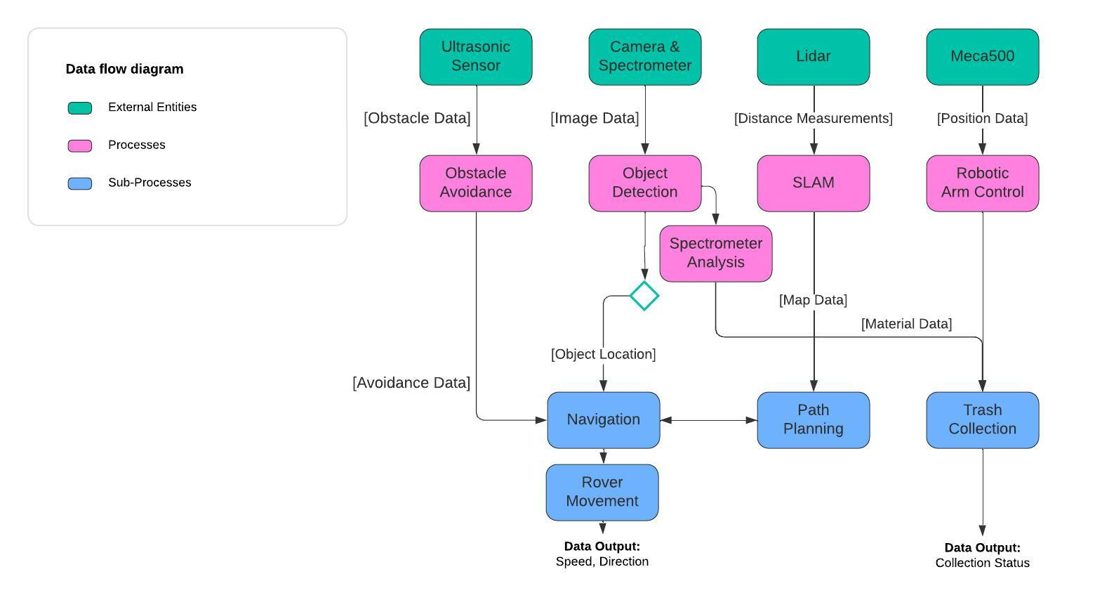
ALICS dataflow diagram
High-level overview description of how data will flow throughout the various components and processes of ALiCS’ software.
At the top of the figure are the external entities and key components of ALiCS, which each transfer data to their respective process.
Notes:
Andre
Our dataflow diagram shows how the external entities transfer their respective data throughout the entire software system. The sensors onboard send obstacle data to the obstacle avoidance process, which then is used for the robot’s navigation. The camera & spectrometer send image data to the object dection module which branches out to spectrometer analysis and navigation again. The data from the Lidar puck is necessary for our SLAM module which provides map data to aid in path planning. Navigation & Path planning go hand in hand to carry out the rover’s complete movements. Finally our last external entity, the Meca500 arm, sends out its positional data to Arm control for proper movements before trash is collected.

Slide 40
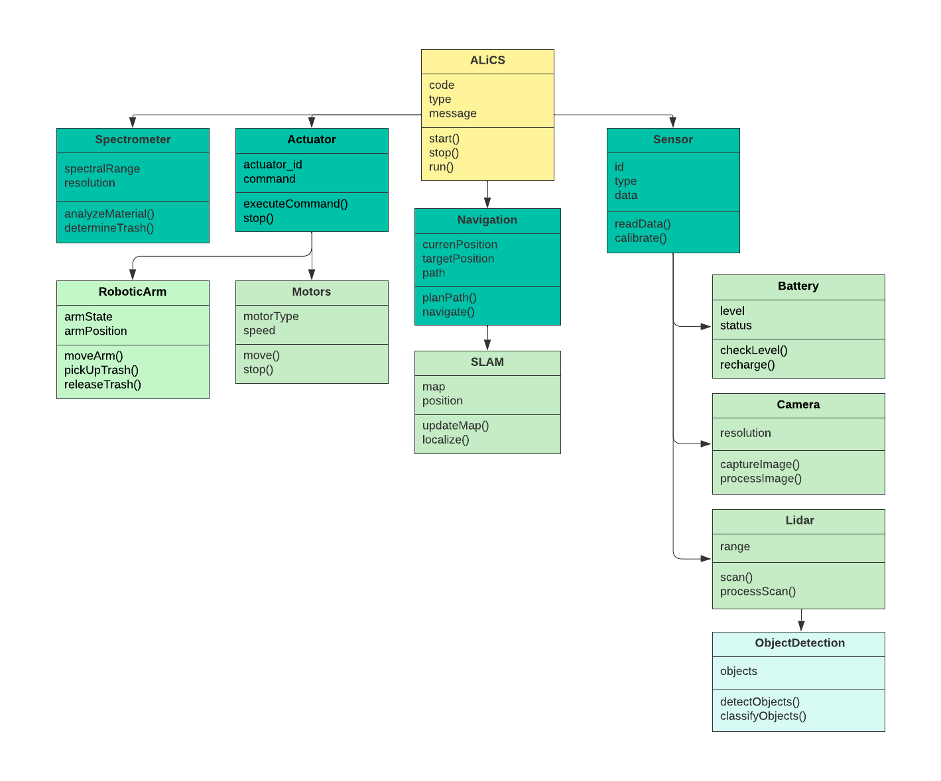
Class diagram
Notes:
Andre
This diagram shows the inheritance relationships, key methods, and attributes of the classes involved in theALiCS software. The class hierarchy begins with ALiCS as the parent class, or base class for all components involved. The Spectrometer class inherits from ALiCS and handles analysis of the objects to classify whether they are trash or not. The Actuator class stems from the parent class as well and handles all actuators the robot contains, in this case the Meca500 arm and the motors.
The robotic arm will perform trash collection as necessary, and the motors will control the movement of the rover as well as the speed. The Navigation class is responsible for the path planning and following, which stems into the SLAM class that is responsible for simultaneous localization and mapping, including map updates. The Sensor class contains all sensors used in the project, including the battery sensors which determine if ALiCS has low battery and needs a recharge, the Camera and Lidarclasses implement specific methods for their specific functionalities, and finally ObjectDetection, which handles the detection and classification of the objects located in the rover’s environment.

Slide 41
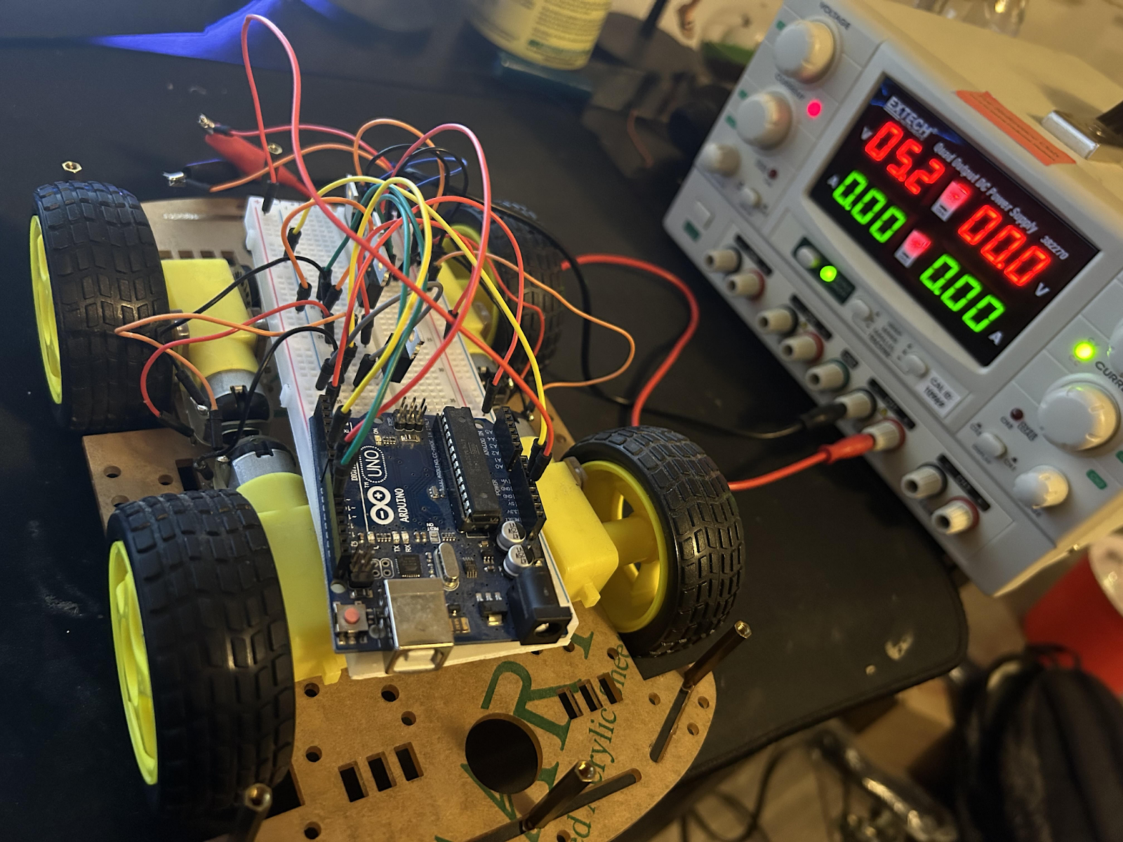
Hardware testing
Rover:
Testing the capabilities and compatibilities of the motors, motor drivers, and the wheels
Raspberry Pi & ESP32:
ESP32 tested as the central hub for sensor data handling, real-time tasks, communication with the Raspberry Pi & motor control.
Raspberry Pi tested for communication with the LiDAR puck and camera.
Notes:
Luis, here we have how we plan testing the hardware, for the rover we will begin (READ) on the right you can see a picture of our very early testing of a rover. For the raspberry pi and esp 32, (READ ALL)

Slide 42
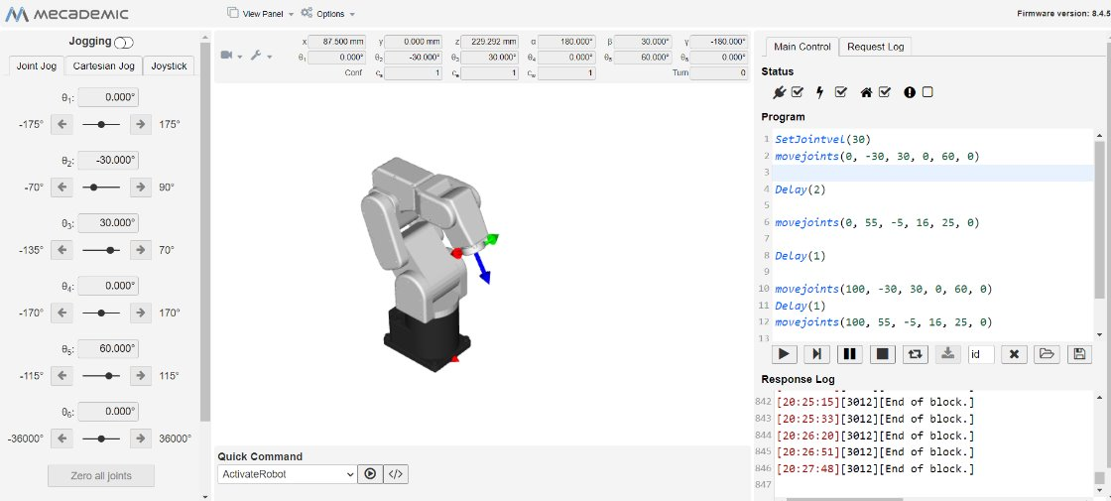
HARDWARE TESTING
Meca500 Robot Arm:
Tested for movement precision and object manipulation with the gripper.
Commands are executed in MecaPortal such as 'movelin' & 'movejoints'.
Verified arm's ability to pick and place objects.
Sensors, Spectrometer & LiDAR:
The ultrasonic sensors are tested for obstacle detection & distance accuracy.
Ensure the LiDAR puck can capture a 360° view of its surroundings and transmit point cloud data.
The spectrometer will be tested to analyze and identify the following test samples: red solo cups, beer cans, and beer bottles.
Notes:
Andre

Slide 43
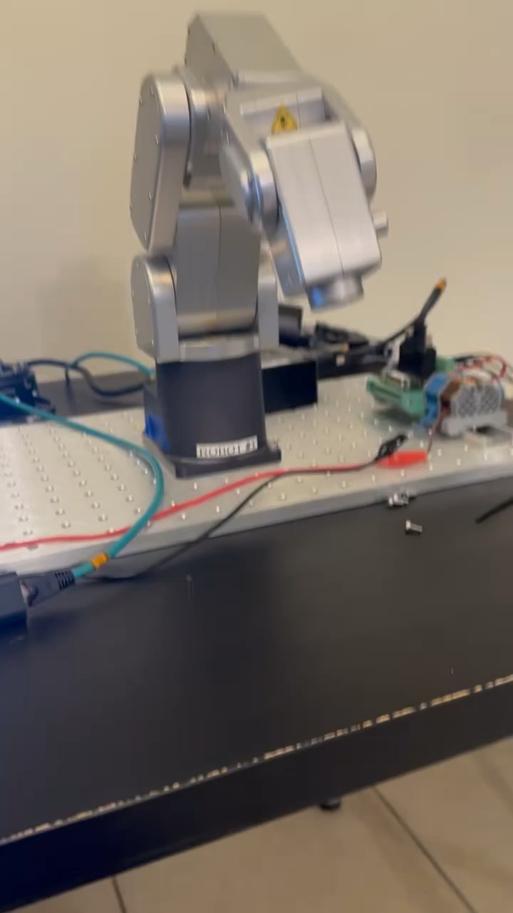
Notes:
Andre
This demo shows the robot arm start at home base, which then drops down to pick up an object, then brings the object up to the spectrometer for analysis. After analysis is complete the robot turns around and drops the trash in its respective bin. The arm repeats the process for another object on its side.

Slide 44
SOFTWARE TESTING
SLAM Module:
Tested for real-time mapping and localization using camera data and LiDAR
Verify robot's ability to avoid obstacles and update map.
YOLO:
Tested in identifying trash types (glass, plastic, metal) from camera input.
Real-time detection speed and false positives were measured and optimized.
Notes:
Andre

Slide 45
INTEGRATION & SYSTEM TESTING
Hardware & Software Integration:
Full-system operational test, including battery performance, speed, first in controlled environments, then precision in real-world beach environments.
Verified seamless communication between the hardware components (sensors, actuators) and software modules (ROS, SLAM, YOLO).
Reference samples from Ocean Optics Flame – NIR+ Spectrometer
Performance Under Load:
Stress-tested under varying conditions such as uneven terrain and different types of objects.
Notes:
Mario
Our design is consist of 6 separate operators, the robot arm/claw, motor, LiDAR, Camera, Spectrometer, Power/PCB.
We believe operating each of these separately should be easy, in fact we have some of them operating already. The true test will be in the software and integrating all the equipment to communicate effectively.
System integration will require a lot of time, attention, and testing. We believe we can accomplish this because our group consist of 3 computer science majors and look forward to this challenge.

Slide 46
Distribution of work
Team Member | Responsibility | Tasks
Mary Bartlinski | Program Camera Vision | -Set up Camera with YOLO (object detection) -Program LiDAR with SLAM (environment mapping) -Integrate Camera and LiDAR with robot arm
Sean Waddell | Power & PCB Design | -Design the power system that will allow power to flow throughout the whole robot; -Design the PCB that has all the peripheral, memory, and other specified requirements.
Luis Hernandez | Self-driving Rover | -Design rover strong enough to hold the robot arm -Program motors for self-driving -Integrate motors with camera and arm
Andre Reveles | Robotic Arm | -Set up robot arm with MecaPortal -Program the arm to pick up trash and move -Integrate the arm with camera and LiDAR
Mario Puesan | LiDAR & Spectrometer | -Design and implement a spectrometer to detect trash sorting -Construct the rover -Integrate Spectrometer with robot arm
Notes:
Mario

Slide 47
Design Constraints
Safety – keeping beachgoers and sea life safe during operation.
Time – requires attention almost daily from all team members
Cost - leveraging resources to help keep cost down
Durable and protection from the elements
Finding a suitable breakout board for the motor driver to test with
Mechanical design learning
Notes:
Mario
Safety – while keeping safe practices at the forefront of our design, we had to ensure public safety and sea life were preserved. For example, using light sources that could potentially cause damage to the eyes of surrounding beach goers and researching softer wheels that won't crush sea turtle nesting areas.
Time – Considering we began developing in the Summer semester, this complex system requires daily attention to be successful. We believe system integration and testing will consume a lot of time
Cost - While we leaned towards off the shelf parts to keep cost and lead times to a minimum, developing an autonomous robot that utilizes optics as a subsystem can become costly very quickly. Leveraging resources can help cut cost.
Durability – The system requires a lot of power to move the robot across the beach with a significant amount of weight, we had to go with beefier motors that required a significant amount of power going through our power distribution board.
Lastly – to help keep cost down,

Slide 48
Budget
Part | Quantity | Price
Wheels | 4 | $120
57BLF03 Motors | 4 | $144
HC-SR04 Sensor | 2 | $18
Battery EXP12200 | 2 | $80
ESP32 | 1 | $10
Raspberry Pi 4 | 1 | $60
Meca500 Arm | 1 | On Loan
Robot Claw | 1 | On Loan
LiDAR Puck | 1 | $98
Rasp Pi Camera | 1 | $36
Enclosure | 1 | Donation
Misc Wiring/connectors | 1 | Donation
Spectro Slit | 1 | $113
Spectro Mirror | 2 | $133
Notes:
Mario
By leveraging resources available to our team, we were able to keep cost down and have a unique design. The remaining cost will be divided by our group members.

Slide 49
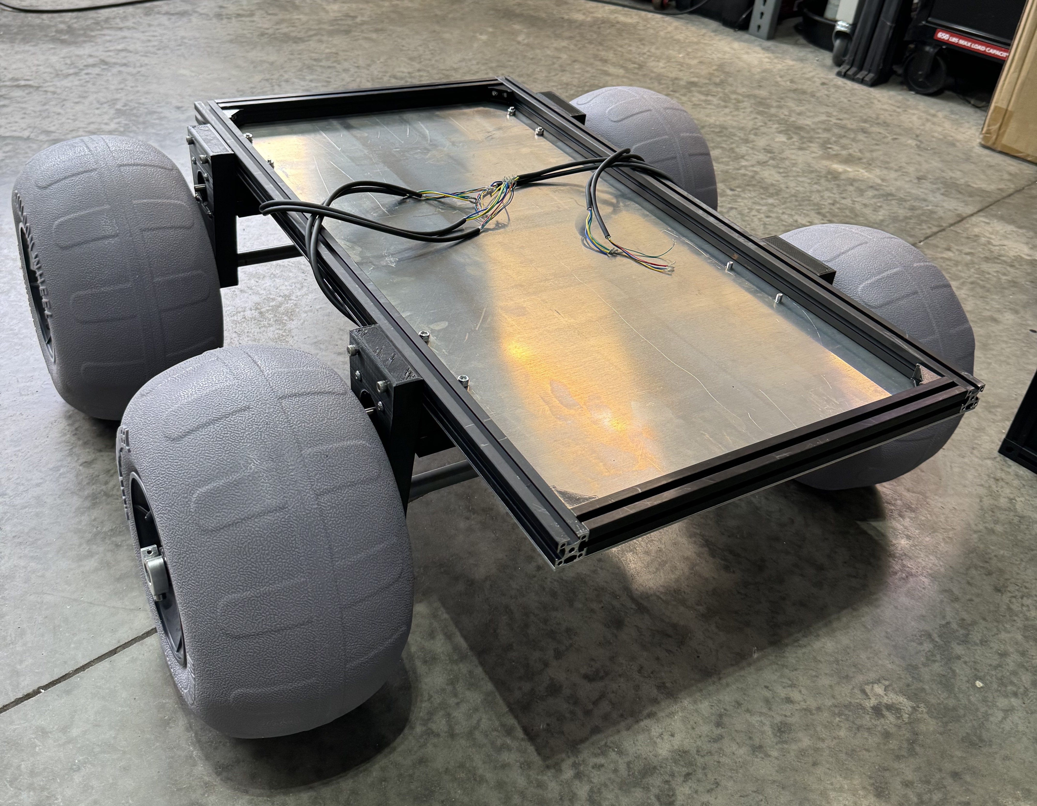
Future Milestones
Present
1-2 weeks out
4-5 weeks out
8-9 weeks out
Arm is fully functional correct range of motion
Base of rover complete
Spectrometer built and mounted
PCB constructed and fully operating
Hardware is finished and integrated
Midterm Demo
6-7 weeks out
Software is finsihed and integrated
Troubleshooting
Senior Showcase
Notes:
Mary
Now lets look at our future progress to get a better understanding of where we are. Currently, we reached two major achievements. We can communicate with the robotic arm and it is fully functional. We also have the frame of the rover complete as shown on the slide. In the next 1-2 weeks, our focus will be on getting our sensors integrated and mounted onto the rover. At the same time, the pcb will be constructed and fully operational. Looking ahead to week 4-5, we expect all hardware components to be finished and mounted onto the rover, as well as, integrated. During this time, we will present our midterm demo. By the time we reach 6-7 weeks, all software should be fully functional and integrated. Here, we’ll also spend time troubleshooting and testing the overall prototype to make sure everything runs smoothly. Finally, we will present ALiCS in its final form in the senior showcase.

Slide 50
Thank you for watching
Notes:
Mary
Thank you for taking the time to watch and hear about ALiCS and we are happy to answer any questions.

